Slide 1
Number Administration
A. Number Search and Reservation (NUS)
B. Reserved Number List (RNL)
C. Allowable NPA for Dial# (AND)
D. Reservation Limit (REL)
SMS/800 ® is a registered trademark of SMS/800, Inc.
Notes:
Number Administration…
In this Number Administration module we will look at 4 screens.
(Click) The Number Search and Reservation (NUS) screen
(Click) The Reserved Number List (RNL)
(Click) The Allowable NPA for Dial# (AND) … And the
(Click) Reservation Limit (REL) screen

Slide 2
NA - Number Administration Statuses
Dial Numbers can be in one of the following 8 NUS statuses:
* Q4 = Quadrant 4 of NUS
1. Spare – A toll free number that is available for use by a customer.
2. Unavailable - that has been taken out of use. (by Help Desk)
3. Reserved - that is held for future use by a customer. (45 days)
4. Assigned - with a CAD that is not yet active.
5. Working - that is Active or Sending.
6. Disconnect - whose service has been terminated. (4 months)
7. Suspend - that is Disconnected with a future re-activation.
8. Transitional - whose service has been terminated and is past the End Intercept Date but less than 4 months.
Notes:
There are 8 Number Administration Statuses.
(Click)
Each Toll Free number will be in one of the following 8 NA statuses.
(Click)
Spare – A toll free number that is available for use by a customer.
(Click)
2. Unavailable - that has been taken out of use. (by Help Desk)
(Click)
3. Reserved - that is held for future use by a customer. (45 days)
(Click)
4. Assigned - with a Customer Record that is not yet active.
(Click)
5. Working - that is Active or Sending.
(Click)
6. Disconnect - whose service has been terminated. (The default length of disco is 4 months)
(Click)
7. Suspend - that is Disconnected with a future re-activation.
(Click)
8. Transitional - whose service has been terminated(disconected) and is past the End
Intercept Date but less than 4 months.
(Click)
These Statuses are viewed in the Q4 (4th quadrant of the NUS screen)
(Click)

Slide 3
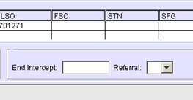
Disconnect vs. Transitional
When End Intercept is reached…
NA status changes from Disco. to Trans.
CR is deleted (no more CAD)
CR is taken out of SCP
2/01/10
6/01/10
DISCONNECT
(4 Months)
3/1/10
3/01/10 End Intercept (default = 4 mo)
DISCONNECT
TRANSITIONAL
Notes:
Lets us look more closely at the Transitional Status, as it is one of the more difficult to understand…
(Click) when a customer record is disconnected, an Effective date is
designated for the disconnect. (i.e. 2/1/10)
(Click) to prevent an new end user (i.e.Toms flower shop) from getting the
old end user’s (i.e. Mary’s Trucking) calls, the default End Intercept date is entered 4 months past the Effective Date.
(Click) (i.e. 6/1/10)
(Click) Here is the end intercept field of the CAD.
it is a changeable field during the disconnect process. Suppose we enter
the End Intercept of (3/1/10).
(Click)
(Click) Still, the record will rest for a total period of 4 months, but the NA status will show Disconnect…
(Click) up to 3/1/10 and Transitional
(Click) from 3/1/10 to the end of the 4 months (6/1/10).
(Click) Three actions take place when the end intercept is reached.
(Click) 1. NA Status changes from Disco to Trans
(Click) 2. CR is deleted (No more CAD)
(Click) 3. CR is taken out of the SCP

Slide 4
Number Search and Reservation (NUS)
1. Click the plus sign beside Number Admin on the Main Menu.
2. Double-click the Number Search and Reservation (NUS) option.
1
2
3
4
Notes:
Let us now look at the NUS screen. From this screen we can search and reserve toll free numbers for our Resp Org.
(Click) Click the + sign by the Number Admn in the Main Menu.
(Click) Double click the NUS option in the list. I have numbered the 4 sections of the NUS from 1 to 4.
(Click) Quad 1 - Search
(Click) Quad 2 – Search Results
(Click) Quad 3 – Reservation Information
(Click) Quad 4 – Number Information

Slide 5
NUS - Search
1
Quantity | To determine the quantity of numbers in a search.
Consecutive | Retrieved numbers be in sequence.
Resp Org | Pre-populated with the user’s Resp Org Id. (Protected)
Dial#s | Used to enter up to ten specific numbers or wildcards.
NPA | Used to specify the NPA of the DIAL#s being sought.
Start NXX | Used to begin the search at a specific NXX.
Start Line# | Used to begin the search at a specific line number.
Search Button | Initiates search for all of the Dial#s entered.
Note: Data cannot be entered in the DIAL# and NPA field during the same search. No wildcards in the NPA… Start NXX… or Start Line#… fields
Notes:
(Click) Quad 1 is the Search Quadrant of the NUS.
(Click) The fields of NUS include:
(Click) Quantity - To designate the quantity of numbers in a search. Max of 10
(Click) Consecutive – returns only Retrieved numbers in sequence.
(Click) Resp Org - Pre-populated with the user’s Resp Org Id. (Protected)
(Click) Dial#s - Used to enter up to ten specific numbers or wildcards.
(Click) NPA - Used to specify the NPA of the DIAL#s being sought.
(Click) Start NXX - Used to begin the search at a specific NXX.
(Click) Start Line# - Used to begin the search at a specific line number.
(Click) Search Button - Initiates search for all of the Dial# parameters entered.
(Click) Note: Data cannot be entered in the DIAL# and NPA field during the same search. No wildcards allowed in the NPA… Start NXX… or Start Line#… fields

Slide 6
NUS – Search Results
2
Dial# | Displays the numbers for the search criteria entered in the Search Area.
Last Active | For a Reserved or Spare number, this is the last date the number was Under a specific Resp Org ID.
Reserve Button | Used with the Contact Person and Number to Reserve a number.
Check Status Button | Checks the status of the Reservation process of the Search Results area.
Get Info Button | Used to populate the Number Information area. (Q-4)
Notes:
(Click) Quad 2 is the “Search Results” quadrant of the NUS. Here are displayed the results of our search from quadrant 1.
(Click) The field columns of Quad 2 are:
(Click) Dial# - Displays the resulting numbers for the search criteria entered in the Quad 1
(Click) (Click) Last Active - For a Reserved or Spare number, this is the last date the number was Under a specific Resp Org ID.
(Click) (Click) Reserve Button - Used to Reserve a number. The Contact Person and Number of Quad 3 are required for Reservation.
(Click) Check Status Button - Checks the status of the “waiting” Reservation process in the Search Results area.
(Click) Get Info Button - Used to populate the Number Information section. (Q-4)
(Click) Status - See next slide…

Slide 7
NUS – Search Results Status
2
Status Q2 – In Quadrant 2 of the NUS | Displays the Search Results Status for each number in the adjacent field.
 | Waiting | The number is being Reserved.
 | On Hold | A different user has the number in Waiting or a pre-reservation state exists on number.
 | In Use | The number is not Spare.
 | Failed | The number cannot be reserved.
 | Closed | The NPA-NXX is closed. (800-555)
 | Reserved | The number is Reserved.
Notes:
(Click) The Search Results Status of Quad 2 Displays the
(Click) (Click) Search Results Process Status for each number in the adjacent field.
(Click) If the status displays “Waiting” that means the Reservation request has been sent but the results have not yet reached your PC.
(Click) (Click) If the status displays “On Hold”, a pre-reservation state exist on the number. (Some other user in the SMS/800 is looking at this number) They have 1 minute.
(Click) (Click) In Use means the number is not SPARE.
(Click) (Click) Failed means the process to reserve the number did not complete.
(Click) (Click) Closed means the NPA-NXX is a closed code (i.e. 800-555)
(Click) (Click) Reserved means you have succeeded in reserving the number.
(Click)

Slide 8
NUS – Reservation Information
3
Contact Person | Required when the number status is changed to Reserved. Default from the First Tab of ROP screen.
Contact Number | Required 10 digit number when the number status is changed to Reserved. Default = First Tab of ROP
Notes - Optional | Up to 72 alphanumeric and special characters. From ROP
Search & Reserve Button | Search and reserve a number in fewer steps.
Refresh | Replaces the Contact Person, Number and Notes with the default reservation contact information.
Change Defaults | Displays the ROP/URC screen for your Logon ID, and allows you to change the reservation contact default Info.
Notes:
(Click) Quadrant 3 is the Reservation Information section of the NUS. Normally this section contains information about the User who actually reserves the number. Listed here on my NUS is my information. When I reserve a number this information is attached to the Toll Free number. The fields of this section are:
(Click) (Click) Contact Person - Required entry when the number status is changed to Reserved. Default comes from the First Tab of ROP screen.
(Click) (Click) Contact Number - Required 10 digit number when the number status is changed to Reserved. Default = First Tab of ROP
(Click) (Click) Notes – Optional… Up to 72 alphanumeric and special characters. From ROP
(Click) (Click) Search & Reserve Button - Allows a Search and reserve in fewer steps. Enter search criteria in Quad 1 and press this button.
(Click)
(Click) (Click) Refresh - Replaces the Contact Person, Number and Notes with the default reservation contact information of ROP.
(Click) (Click) Change Defaults - Displays the ROP/URC screen for your Logon ID, and allows you to change the default reservation contact default Info.

Slide 9
NUS – Number Information
4
Control Resp Org | 5 alpha and numeric characters. (protected)
Status | NA (Number Administration) Status.
Eff. Date - Protected | This field shows the date on which the numbers were given their current status.
Reserved Until | If the status is Reserved, this field shows the day the number will be returned to Spare status.
Disconnect Until | The end-intercept date for the number. (Protected)
Last Active - Protected | For a Reserved or Spare number, this is the last date the number was Active.
Update button | Used to save any changes made to Q4 the NUS.
Notes:
(Click) Quadrant 4 is the “Number information” section of the NUS. This Section is populated after pressing “Get Info” of Quad 2.
(Click) (Click) Control Resp Org - 5 alpha and numeric characters. (protected)
(Click) (Click) Status – NA (Number Administration) Status. One of the 8 NA statuses
(Click) (Click) Eff. Date – Protected… This field shows the date on which the numbers were given their current status under this RO id.
(Click) (Click) Reserved Until - If the status is Reserved, this field shows the day the number will be returned to Spare status.
(Click) (Click) Disconnect Until - If the status is Disconnect, this is the end-intercept date for the number. (Protected)
(Click) (Click) Last Active – Protected… For a Reserved or Spare number that was once in use, this is the last date the number was Active before being returned to spare.
(Click) (Click) Update button - Used to save any changes made to Q4 the NUS.
(Click)

Slide 10
Types of Number Searches
Search for any spare number.
Search for a specific number.
Search for a partially specified number.
Search for Vanity Number.
Search for spare number in a specific NPA. (2 ways)
Search for spare numbers with a specific NXX.
Search for spare numbers in a specific NPA-NXX.
Start the search at a specific NXX.
Start the search at a specific line number.
Search for a block of consecutive spare numbers.
Search for a spare number with repeating digits.
Notes:
There are many types of searches that can be made from the NUS.
(Click)Search for any spare number.
(Click)Search for a specific number.
(Click)Search for a partially specified number.
(Click)Search for Vanity Number.
(Click)Search for spare number in a specific NPA. (2 ways)
(Click)Search for spare numbers with a specific NXX.
(Click)Search for spare numbers in a specific NPA-NXX.
(Click)Start the search at a specific NXX.
(Click)Start the search at a specific line number.
(Click)Search for a block of consecutive spare numbers.
(Click)Search for a spare number with repeating digits.

Slide 11
Search for Any Spare Number
Click the Search button, located in the Search area.
Notes:
To search for any available Spare number, simply press the Search button in Quad 1. Or use the keystroke Ctrl+N.
(Click)

Slide 12
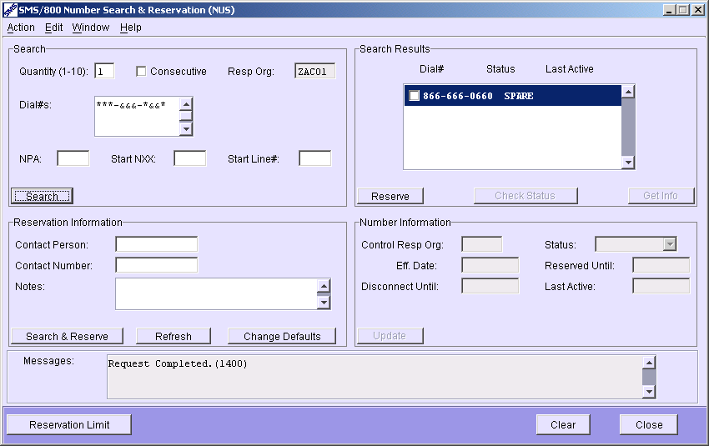
Search using Wildcards
Type a Dial Number using the asterisk (*) and ampersand (&) symbols in the Dial Number field ONLY.
Click the Search button.
* | Any Digit
& | Repeating Digit
Notes:
There are two wildcards available for use in the Dial # field of the NUS.
(Click1) The Asterisk and the Ampersand. The Asterisk returns any digit in its place. The Ampersand will return repeating digits wherever the Ampersand is placed.
(Click2) To use the wildcards, type ten wildcards in the Dial# field. i.e. ***&&&*&&*
(do not use the Start NXX field as it just starts the search at the NXX)
(Click3) Then select the Search Button…
(Click4) (Click5) (or the Search and Reserve button in Quad 3.)
(Click6)

Slide 13

Specific NXX Search
1. Type (***314****) in the Dial Number field. (not Start NXX)
2. Click the Search button.
Notes:
To search for a Toll free number with a specific NXX,
(Click1) surround the 314 with asterisks in the Dial # field. Not in the Start NXX. i.e. ***314****
(Click2) and press the Search button.
(Click3) Or you can select the Search and Reserve button
(Click4)
(Click5)

Slide 14
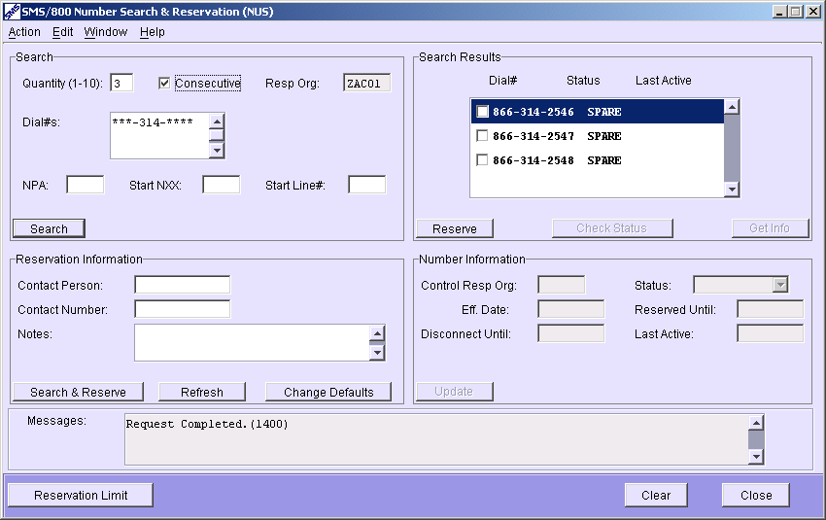
Search for Consecutive Spare Numbers
1. Type the amount of numbers in the Quantity field.
2. Check the Consecutive box.
3. Enter the requirements in the Dial Number or NPA, Start NXX, and/or Start Line # fields. i.e. ***314****
4. Click the Search button.
3
√
Notes:
To search for Consecutive Spare Numbers…
(Click1)
Type the amount of numbers in the Quantity field.
(Click3) (Click4)
2. Check the Consecutive box.
(Click5) (Click6)
3. Enter the requirements in the Dial Number or NPA, Start NXX, and/or Start Line # fields. i.e. ***314****
(Click7)
4. Click the Search button.
(Click8)

Slide 15
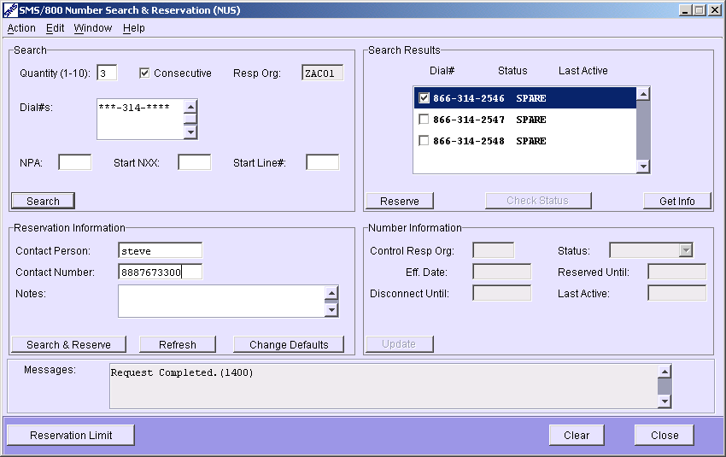
Reserving a Spare Number
1. Enter (or Refresh) the Contact Person and Number in the Reservation Information area.
2. Check the Dial Number(s) in the Search Results area.
3. Click the Reserve button.
Notes:
To reserve a Spare Number… first complete a search in Quad 1
(Click1)
1. Enter (or Refresh) the Contact Person and Number in the Reservation Information area.
(Click2) (Click3)
2. Checkmark the Dial Number(s) that you want to reserve in the Search Results area.
(Click4) (Click5)
3. Click the Reserve button.
(Click6)(Click7)
(Click8)

Slide 16
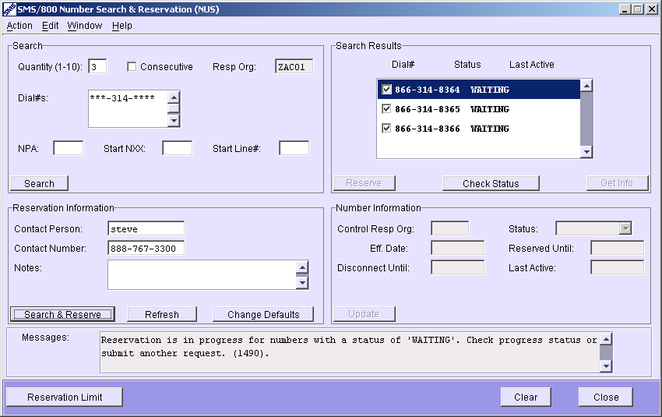
One-Step Search and Reserve
1. Enter the amount of numbers in the Quantity field.
2. Enter the requirements in the Dial Number, NPA, Start NXX, and/or Start Line # fields.
Enter (or refresh) the Contact Person and Number in the Reservation Information area.
4. Click the Search
& Reserve button.
5. Click the Check
Status button.
(skip the Search and
Checkmark steps)
Notes:
The One-Step Search and Reserve is a quicker way to reserve numbers without reviewing your search results.
(Click1)
Enter the amount of numbers in the Quantity field.
(Click)
Enter the requirements in the Dial Number, NPA, Start NXX, and/or Start Line # fields.
(Click)
(Click)
Enter (or refresh) the Contact Person and Number in the Reservation Information area.
(Click) (Click)
Click the Search & Reserve button. The numbers return in “Waiting” status.
(Click) (Click)
If you want to verify that the numbers are reserved, Click the Check Status button.
(Click)
(this faster process skips the Search and Checkmark steps)
(Click)

Slide 17
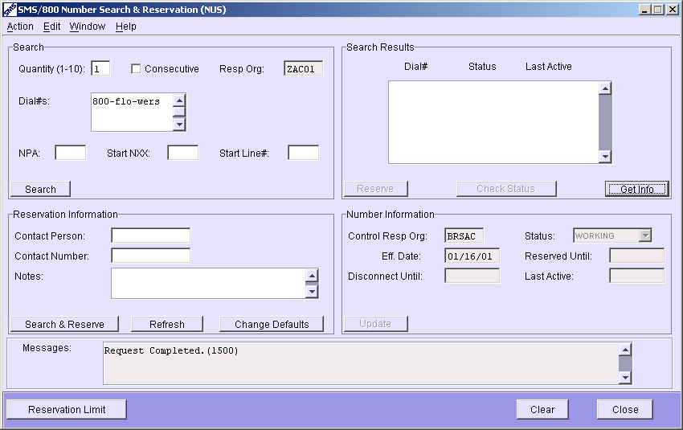
“Get Info” on a Dial Number
1. Enter the requirements in the Dial Number field.
2. Click the Get Info button.
Notes:
To get Number Information (Quad 4) for any number in the Database use the “Get Info” button.
Enter the requirements in the Dial Number field.
(Click) (Click)
2. Click the Get Info button.
(Click) (Click)

Slide 18
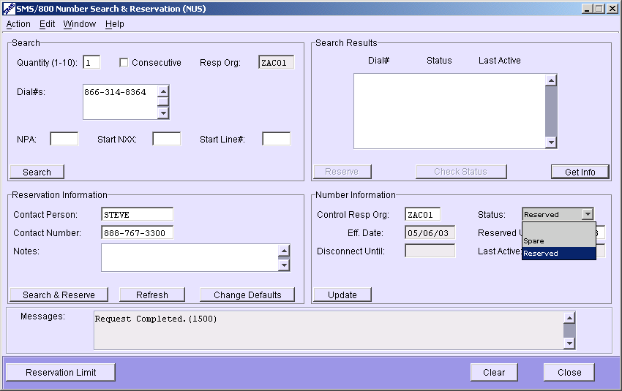
Return Dial Number to Spare
1. Enter the requirements in the Dial Number field.
2. Click the Get Info button. (Reserved or Trans only)
3. Select Spare from the Status drop-down.
4. Click the Update button.
Notes:
To Return a Dial Number in a (Reserved or Transitional status) to Spare…
(Click)
Enter the requirements in the Dial Number field.
(Click) (Click)
2. Click the Get Info button. (Reserved or Trans only)
(Click) (Click)
3. Select Spare from the Status drop-down.
(Click) (Click)
4. Click the Update button.
(Click) (Click)

Slide 19
Allowable NPA for Dial# (AND)
The AND screen is used to view the entire set of NPAs that are valid for Toll-Free Dial Numbers. Random search start = 866
800
855
866
877
888
Notes:
The AND screen is used to view the entire set of NPAs that are valid for Toll-Free Dial Numbers. Random search start = 866
(Click)

Slide 20
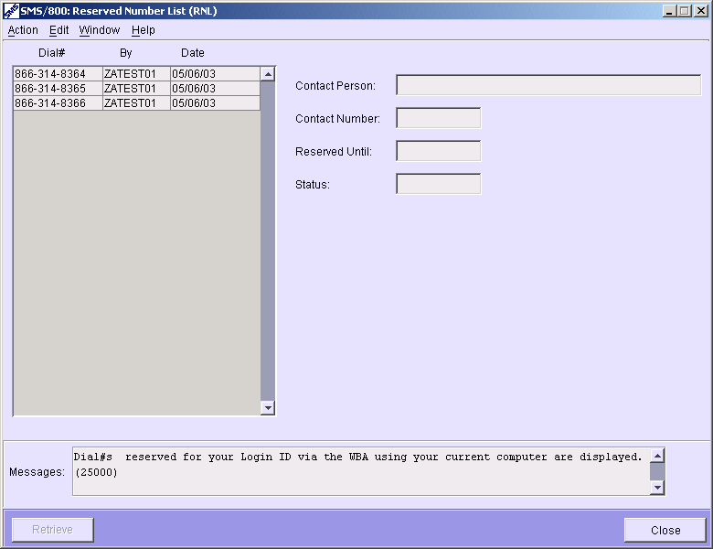
Reserved Number List (RNL)
The RNL window displays a list of numbers that were reserved by a WBA user.
The Reserved Number List is updated each time you:
Reserve a number.
Return a number on your list to Spare.
Create a customer record for one of the numbers on your list.
Change RO (Resp Org)
RNL can be saved as a file on the Users Computer. Select Action menu and Save as File…
Notes:
The RNL (Reserved Number List) window displays a list of numbers that were reserved by a specific Logon ID on a specific hard drive.
(Click)
(Click)
The Reserved Number List is updated each time you:
(Click)
Reserve a number.
(Click)
Return a number on your list to Spare.
(Click)
Create a customer record for one of the numbers on your list.
(Click)
Change RO (Resp Org)
(Click)
RNL can be saved as a file on the Users Computer. Select Action menu and Save as File…
(Click)

Slide 21
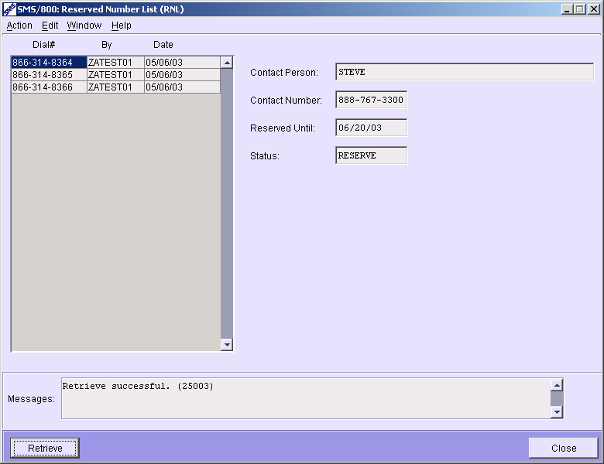
RNL “Retrieve” on a Reserved Number
Select the Dial Number from the Reserved Number List.
Click the Retrieve button.
Notes:
The RNL (Retrieve) shows the Contact Information for a specific Dial # that is listed in the RNL
(Click) (Click)
Select the Dial Number from the list
(Click) Select Retrieve
(Click) (Click)
View the Contact Person, Number, Reserved Until and Status
(Click)

Slide 22
(REL) Reservation LimitS
Dial# Reservation Limit - A Resp Org can have 7.5% of their working numbers (OR) 2000 numbers in Reserved at one time. (Not greater than 3% of all spare)
Pre-Reservation Time Limit - The amount of minutes a Spare number can be viewed on the NUS screen before another user can view that number as Spare.
Enable Blocking - A “YES” entry blocks a Resp Org from reserving numbers past their reservation limit.
Transition to…Reserved to - Time when numbers will begin to be spared.
Notes:
The REL (Reservation Limit) screen displays several parameters for Number Administration.
(Click)
Dial# Reservation Limit
A Resp Org can have 7.5% of their working numbers (OR) 2000 numbers in Reserved at one time. (Not greater than 3% of all spare)
(Click)
Pre-Reservation Time Limit
The amount of minutes a Spare number can be viewed on the NUS screen before another user can view that number as Spare.
(Click)
Enable Blocking
A “YES” entry blocks a Resp Org from reserving numbers past their reservation limit.
(Click)
Transition to…Reserved to
Time when numbers will begin to be spared.

Slide 23
(REL) Remaining Reservation Limit
Max Reservation limit - A Resp Org can have up to 7.5% of their working numbers (OR) 2000 numbers in a Reserved at one time.
Count of Reserved #s - Designates the amount in Reserved Status
Remaining Number of Reservations - Designates how many more numbers can be reserved by this Entity.
Working Numbers Count - Count of all Working numbers for an Entity.
Date/Time Last Refreshed - Date and time the screen info was last updated
Notes:
The bottom part of the REL screen displays (in real time) the remaining reservation limit for the Entity viewing the screen.
(Click)
Max Reservation limit
A Resp Org can have up to 7.5% of their working numbers (OR) 2000 numbers in a Reserved at one time.
(Click)
Count of Reserved #s
Designates the amount in Reserved Status
(Click)
Remaining Number of Reservations
Designates how many more numbers can be reserved by this Entity.
(Click)
Working Numbers Count
Count of all Working numbers for an Entity.
(Click)
Date/Time Last Refreshed
Date and time the screen info was last updated

Slide 24
NUS Review
Number Search and Reservation (NUS)
Reserved Number List (RNL)
Allowable NPA for Dial# (AND)
Reservation Limit (REL)
Written Exercise #2
Hands-On Exercise (2A)

